Slide 1

Weather station
Bosch Career Camp
E.Karamanliev
S.Yordanov
A.Asenov

Slide 2
Topic
Weather Station overview
Hardware modules
Software architectures
UI overview
CLI overview
Documentation
Q&A

Slide 3
Weather Station overview
Measure
Processing
Display
Weather Station
Temperature outside
Temperature inside
Humidity
Ambient light
Gas
Pressure
Time based statistics
Average measurements
Of the sensors
Notifications
Date & Time

Slide 4

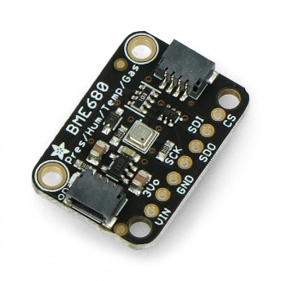
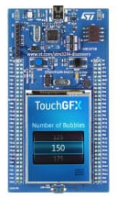
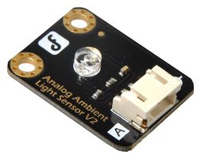
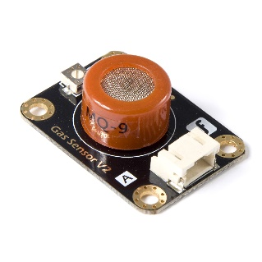
Hardware modules
Weather Station
BME680 Sensor
Ambient Sensor

Slide 5




Software architectures
Weather Station
STM32 CubeIDE
TouchGFX Designer
FreeRTOS
GitHub

Slide 6
System functionalities
User
interface
Command line
interface

Slide 7
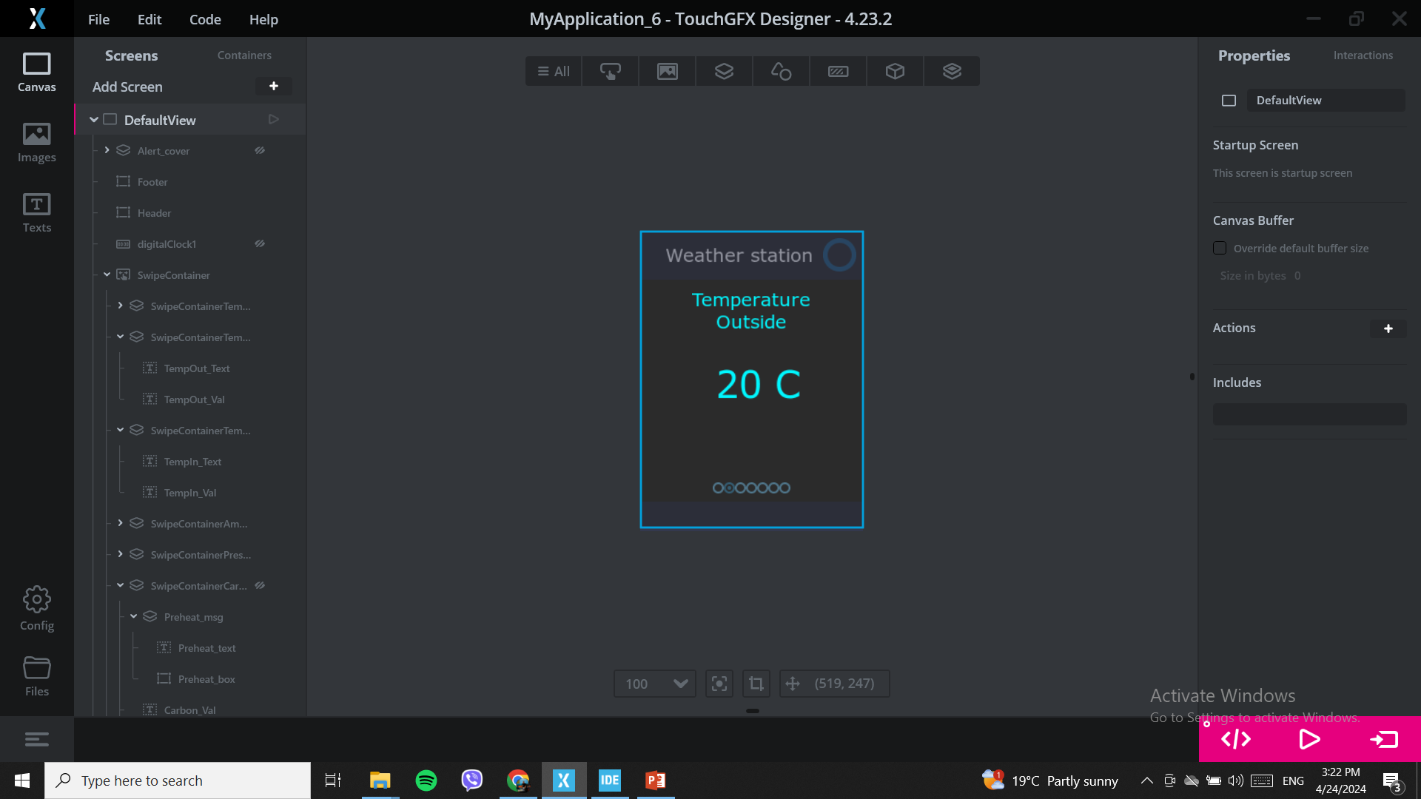
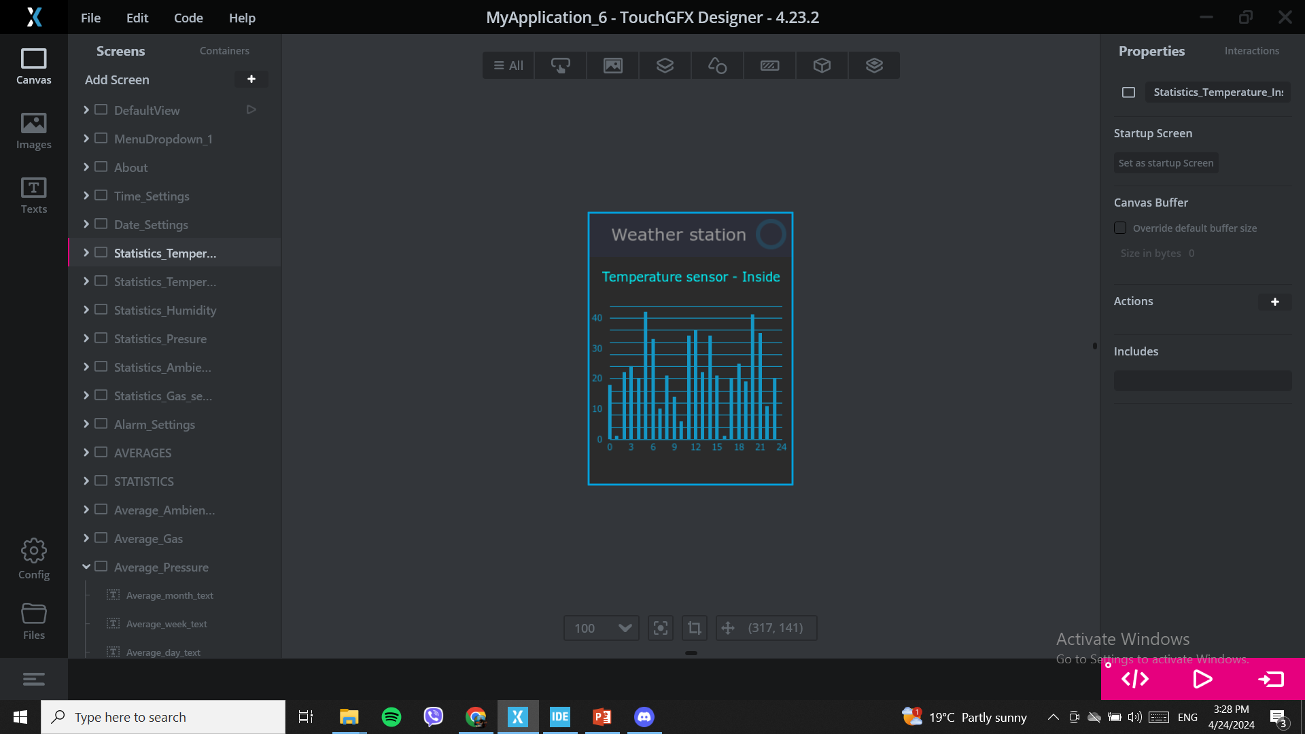
UI overview
Weather Station
UI Functionalities
Displaying Sensor values on the screen
Date & Time options
Device tree
Statistics through the day
Average day / week / month values of the sensors
Automatic brightness screen adjustment based on ASL
Alarm notifications for extremely high or low sensor measurements

Slide 8
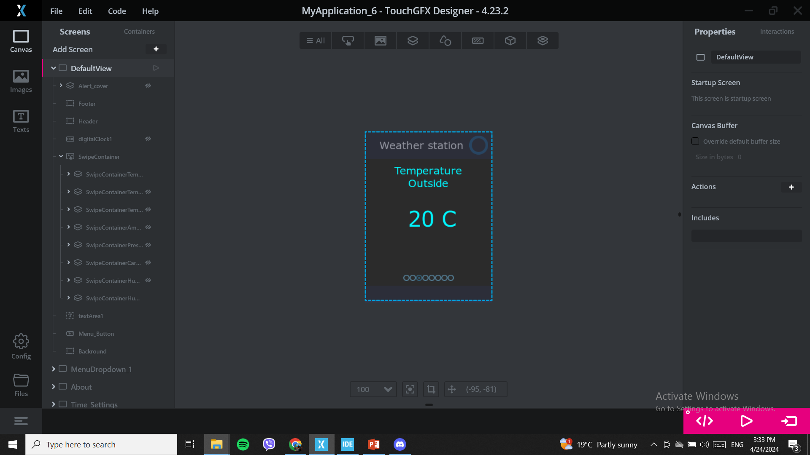




UI overview
Weather Station
UI Functionalities
Displaying Sensor values on the screen

Slide 9
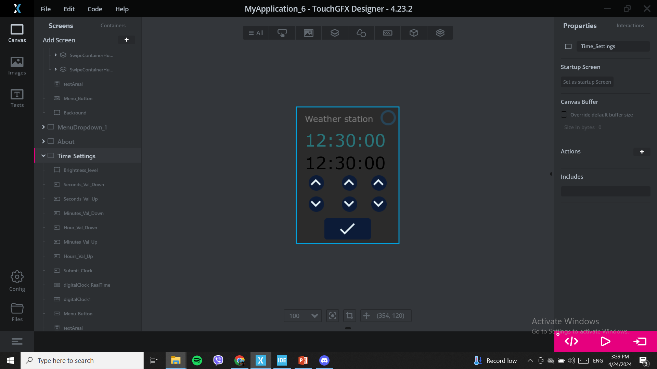

UI overview
Weather Station
UI Functionalities
Date & Time options
Time Page
Date Page

Slide 10
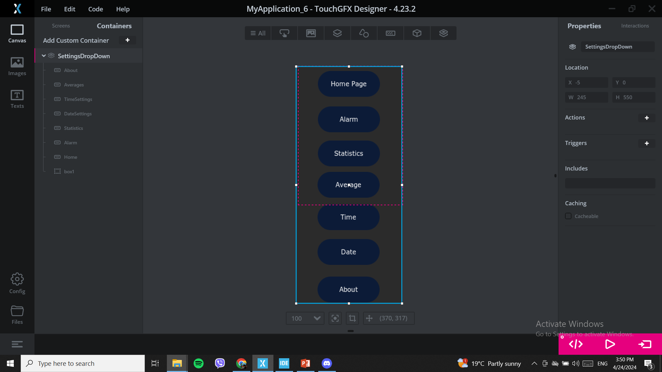
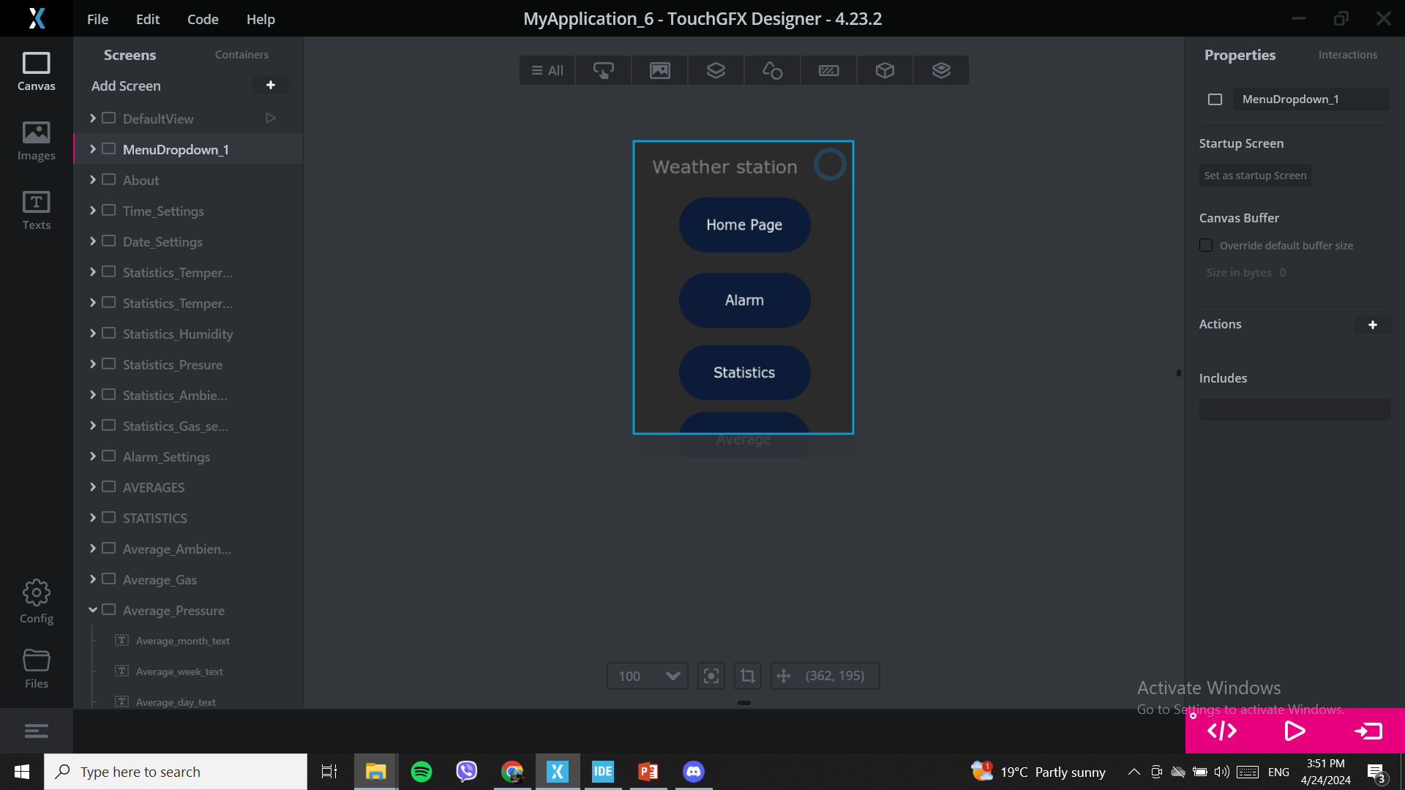
UI overview
Weather Station
UI Functionalities
Device tree
Home page
Alarm page
Statistics page
Average page
Time page
Date page
About page
Menu
Button
Swipe container

Slide 11
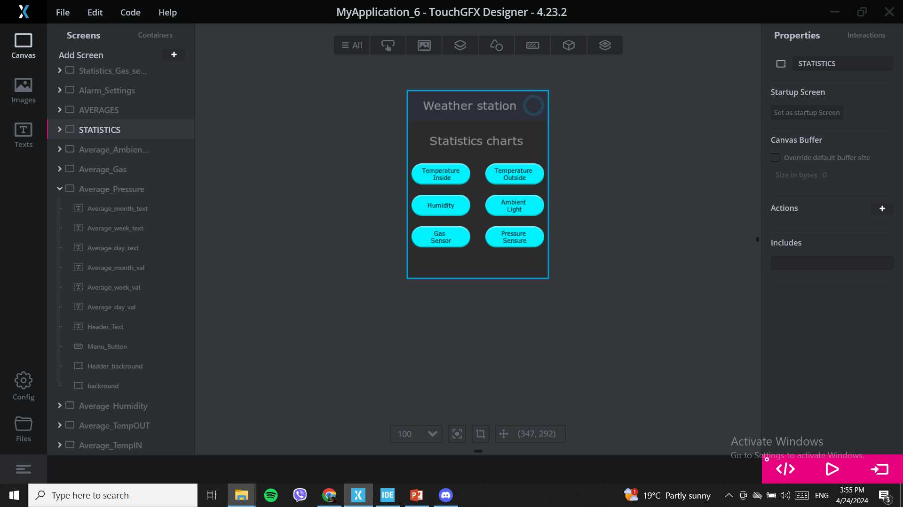
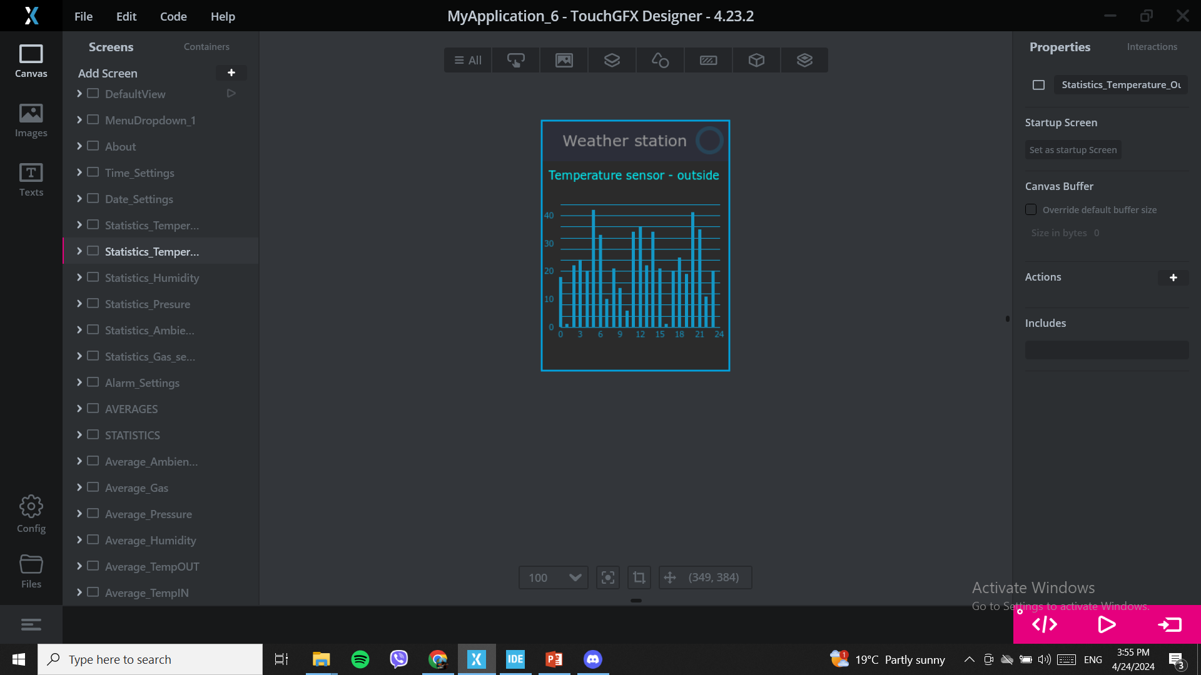
UI overview
Weather Station
UI Functionalities
Statistics through the day
Update statistics char every hour
Separate page for every sensor

Slide 12
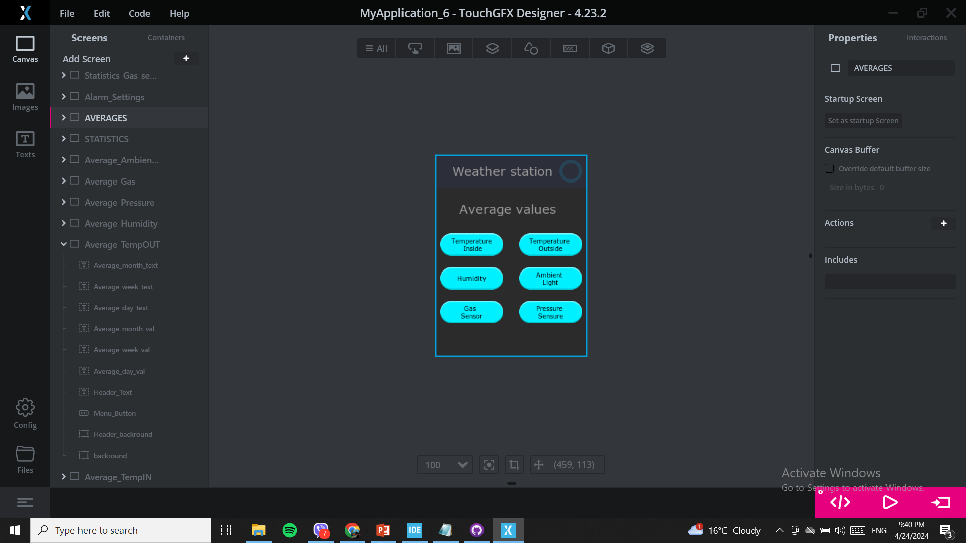

UI overview
Weather Station
UI Functionalities
Average day / week / month values of the sensors

Slide 13
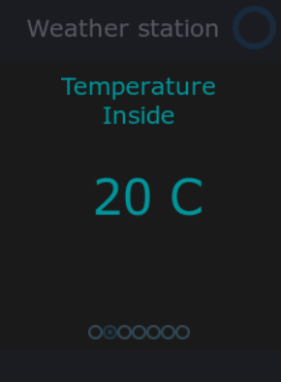
UI overview
Weather Station
UI Functionalities
Automatic brightness screen adjustment based on ASL

Slide 14
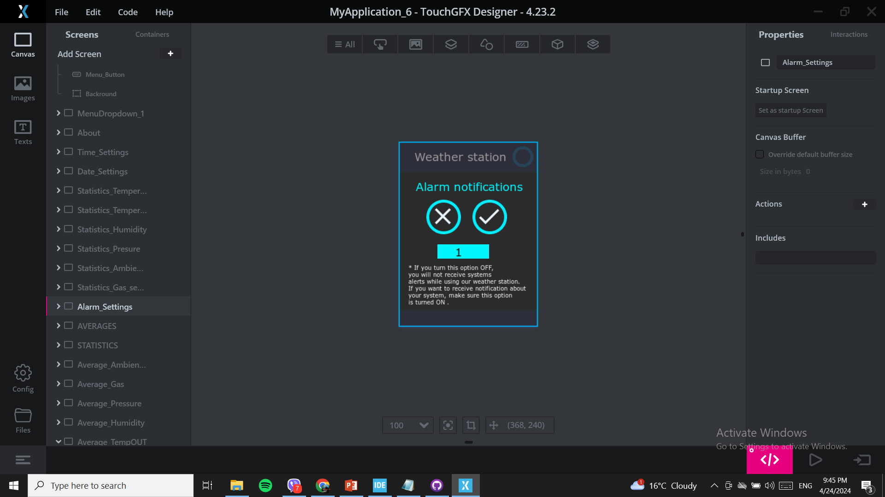
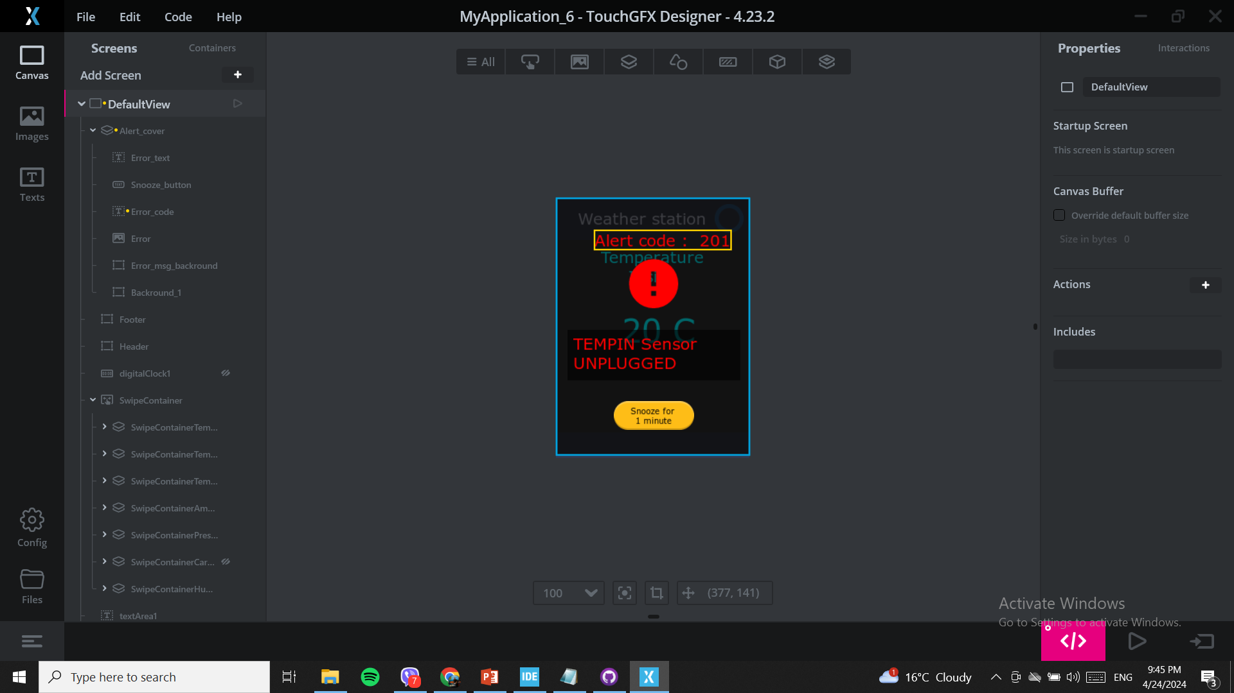
UI overview
Weather Station
UI Functionalities
Alarm notifications for extremely high or low sensor measurements

Slide 15

CLI overview
Weather Station
CLI Functionalities
Displaying Sensor values on CLI
Date & Time options
Help Menu

Slide 16
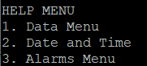
CLI overview
Weather Station
CLI Functionalities
Displaying Sensor values on CLI
Date & Time options
Help Menu

Slide 17
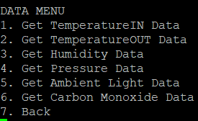
CLI overview
Weather Station
CLI Functionalities
Displaying Sensor values on CLI
Date & Time options
Help Menu

Slide 18
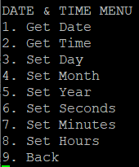
CLI overview
Weather Station
CLI Functionalities
Displaying Sensor values on CLI
Date & Time options
Help Menu

Slide 19

Documentation
Weather Station
Modules
Schematics
Getting Started
Tests
Error Codes
User Manual

Slide 20
Questions ?

Slide 21
Thanks !

